Slide 1
Motivating Employees
Chapter
16
© 2007 Prentice Hall, Inc.
All rights reserved.

Slide 2
What Is Motivation?
Motivation
  Is the result of an interaction between the person and a situation; it is not a personal trait.
  Is the process by which a person’s efforts are energized, directed, and sustained towards attaining a goal.
    Energy: a measure of intensity or drive.
    Direction: toward organizational goals
    Persistence: exerting effort to achieve goals.
  Motivation works best when individual needs are compatible with organizational goals.
© 2007 Prentice Hall, Inc. All rights reserved.
16–<number>

Slide 3
Early Theories of Motivation
Maslow’s Hierarchy of Needs
MacGregor’s Theories X and Y
Herzberg’s Two-Factor Theory
© 2007 Prentice Hall, Inc. All rights reserved.
16–<number>

Slide 4
Early Theories of Motivation
Maslow’s Hierarchy of Needs Theory
  Needs were categorized as five levels of lower- to higher-order needs.
    Individuals must satisfy lower-order needs before they can satisfy higher order needs.
    Satisfied needs will no longer motivate.
    Motivating a person depends on knowing at what level that person is on the hierarchy.
  Hierarchy of needs
    Lower-order (external): physiological, safety
    Higher-order (internal): social, esteem, self-actualization
© 2007 Prentice Hall, Inc. All rights reserved.
16–<number>

Slide 5
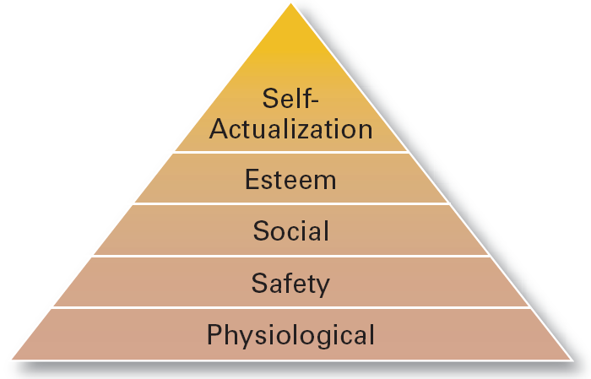
Exhibit 16–1 Maslow’s Hierarchy of Needs
© 2007 Prentice Hall, Inc. All rights reserved.
16–<number>

Slide 6
Early Theories of Motivation (cont’d)
McGregor’s Theory X and Theory Y
  Theory X
    Assumes that workers have little ambition, dislike work, avoid responsibility, and require close supervision.
  Theory Y
    Assumes that workers can exercise self-direction, desire responsibility, and like to work.
  Assumption:
    Motivation is maximized by participative decision making, interesting jobs, and good group relations.
© 2007 Prentice Hall, Inc. All rights reserved.
16–<number>

Slide 7
Early Theories of Motivation (cont’d)
Herzberg’s Motivation-Hygiene Theory
  Job satisfaction and job dissatisfaction are created by different factors.
    Hygiene factors: extrinsic (environmental) factors that create job dissatisfaction.
    Motivators: intrinsic (psychological) factors that create job satisfaction.
  Attempted to explain why job satisfaction does not result in increased performance.
    The opposite of satisfaction is not dissatisfaction, but rather no satisfaction.
© 2007 Prentice Hall, Inc. All rights reserved.
16–<number>

Slide 8
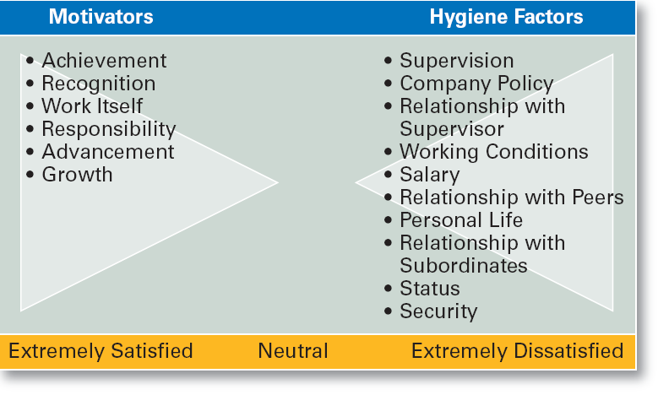
Exhibit 16–2 Herzberg’s Motivation-Hygiene Theory
© 2007 Prentice Hall, Inc. All rights reserved.
16–<number>

Slide 9
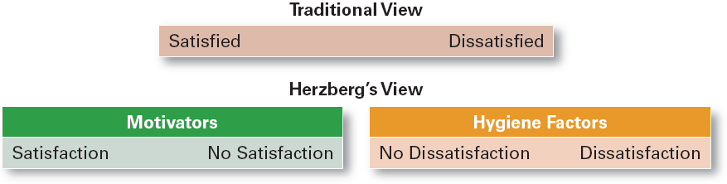
Exhibit 16–3 Contrasting Views of Satisfaction-Dissatisfaction
© 2007 Prentice Hall, Inc. All rights reserved.
16–<number>

Slide 10
Contemporary Theories of Motivation
Three-Needs Theory
Goal-Setting Theory
Reinforcement Theory
Designing Motivating Jobs
Equity Theory
Expectancy Theory
© 2007 Prentice Hall, Inc. All rights reserved.
16–<number>

Slide 11
Current Issues in Motivation
Cross-Cultural Challenges
  Motivational programs are most applicable in cultures where individualism and quality of life are cultural characteristics
    Uncertainty avoidance of some cultures inverts Maslow’s needs hierarchy.
    Collectivist cultures view rewards as “entitlements” to be distributed based on individual needs, not individual performance.
  Cross-Cultural Consistencies
    Interesting work is widely desired, as is growth, achievement, and responsibility.
© 2007 Prentice Hall, Inc. All rights reserved.
16–<number>

Slide 12
Current Issues in Motivation (cont’d)
Motivating Unique Groups of Workers
  Motivating a diverse workforce through flexibility:
    Men desire more autonomy than do women.
    Women desire learning opportunities, flexible work schedules, and good interpersonal relations.
© 2007 Prentice Hall, Inc. All rights reserved.
16–<number>

Slide 13
Current Issues in Motivation (cont’d)
Flexible Work/Job schedules
  Compressed work week
    Longer daily hours, but fewer days
  Flexible work hours (flextime)
    Specific weekly hours with varying arrival, departure, lunch and break times around certain core hours during which all employees must be present.
  Job Sharing
    Two or more people split a full-time job.
  Telecommuting
    Employees work from home using computer links.
© 2007 Prentice Hall, Inc. All rights reserved.
16–<number>

Slide 14
Current Issues in Motivation (cont’d)
Motivating Professionals
  Characteristics of professionals
    Strong and long-term commitment to their field of expertise.
    Loyalty is to their profession, not to the employer.
    Have the need to regularly update their knowledge.
    Don’t define their workweek as 8:00 am to 5:00 pm.
  Motivators for professionals
    Job challenge
    Organizational support of their work
© 2007 Prentice Hall, Inc. All rights reserved.
16–<number>

Slide 15
Current Issues in Motivation (cont’d)
Motivating Contingent Workers
  Opportunity to become a permanent employee
  Opportunity for training
  Equity in compensation and benefits
Motivating Low-Skilled, Minimum-Wage Employees
  Employee recognition programs
  Provision of sincere praise
© 2007 Prentice Hall, Inc. All rights reserved.
16–<number>

Slide 16
Current Issues in Motivation (cont’d)
Designing Appropriate Rewards Programs
  Open-book management
    Involving employees in workplace decision by opening up the financial statements of the employer.
  Employee recognition programs
    Giving personal attention and expressing interest, approval, and appreciation for a job well done.
  Pay-for-performance
    Variable compensation plans that reward employees on the basis of their performance:
      Piece rates, wage incentives, profit-sharing, and lump-sum bonuses
© 2007 Prentice Hall, Inc. All rights reserved.
16–<number>

Slide 17
Current Issues in Motivation (cont’d)
Designing Appropriate Rewards Programs (cont’d)
  Stock option programs
    Using financial instruments (in lieu of monetary compensation) that give employees the right to purchase shares of company stock at a set (option) price.
    Options have value if the stock price rises above the option price; they become worthless if the stock price falls below the option price.
© 2007 Prentice Hall, Inc. All rights reserved.
16–<number>

Slide 18
Leadership
Chapter
17
© 2007 Prentice Hall, Inc.
All rights reserved.

Slide 19
Leaders and Leadership
Leader – Someone who can influence others and who has managerial authority
Leadership – What leaders do; the process of influencing a group to achieve goals
Ideally, all managers should be leaders
Although groups may have informal leaders who emerge, those are not the leaders we’re studying
Leadership research has tried to answer: What is an effective leader?
© 2007 Prentice Hall, Inc. All rights reserved.
17–<number>

Slide 20
Early Leadership Theories
Trait Theories (1920s-30s)
  Research focused on identifying personal characteristics that differentiated leaders from nonleaders was unsuccessful.
  Later research on the leadership process identified seven traits associated with successful leadership:
    Drive, the desire to lead, honesty and integrity, self-confidence, intelligence, job-relevant knowledge, and extraversion.
© 2007 Prentice Hall, Inc. All rights reserved.
17–<number>

Slide 21
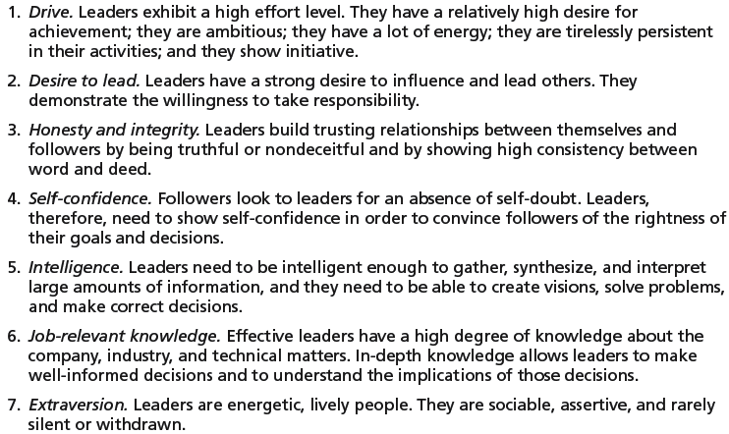
Exhibit 17–1 Seven Traits Associated with Leadership
Source: S. A. Kirkpatrick and E. A. Locke, “Leadership: Do Traits Really Matter?” Academy of Management Executive, May 1991, pp. 48–60; T. A. Judge, J. E. Bono, R. llies, and M. W. Gerhardt, “Personality and Leadership: A Qualitative and Quantitative Review,” Journal of Applied Psychology, August 2002, pp. 765–780.
© 2007 Prentice Hall, Inc. All rights reserved.
17–<number>

Slide 22
Early Leadership Theories (cont’d)
Behavioral Theories
  Leadership theories that identify behaviors that differentiate effective leaders from ineffective leaders.
© 2007 Prentice Hall, Inc. All rights reserved.
17–<number>

Slide 23
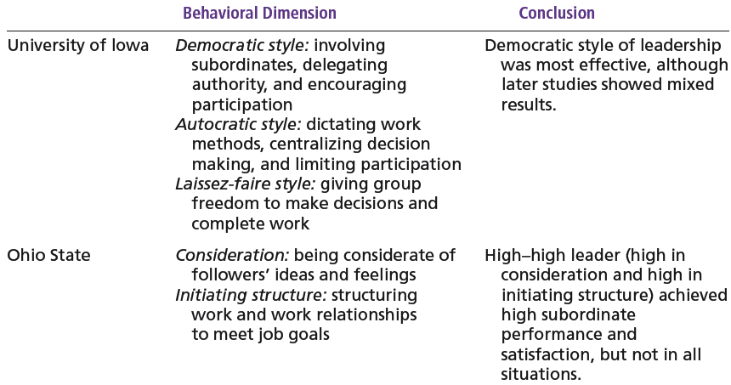
Exhibit 17–2 Behavioral Theories of Leadership
© 2007 Prentice Hall, Inc. All rights reserved.
17–<number>

Slide 24
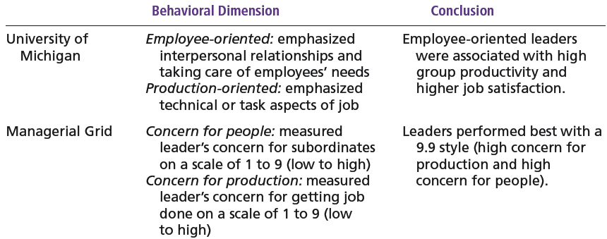
Exhibit 17–2 (cont’d) Behavioral Theories of Leadership
© 2007 Prentice Hall, Inc. All rights reserved.
17–<number>

Slide 25
Contemporary Views on Leadership
Transactional Leadership
  Leaders who guide or motivate their followers in the direction of established goals by clarifying role and task requirements.
Transformational Leadership
  Leaders who inspire followers to transcend their own self-interests for the good of the organization by clarifying role and task requirements.
  Leaders who also are capable of having a profound and extraordinary effect on their followers.
© 2007 Prentice Hall, Inc. All rights reserved.
17–<number>

Slide 26
Contemporary Views…(cont’d)
Charismatic-Visionary Leadership
  An enthusiastic, self-confident leader whose personality and actions influence people to behave in certain ways.
  Characteristics of charismatic leaders:
    Have a vision.
    Are able to articulate the vision.
    Are willing to take risks to achieve the vision.
    Are sensitive to the environment and follower needs.
    Exhibit behaviors that are out of the ordinary.
© 2007 Prentice Hall, Inc. All rights reserved.
17–<number>

Slide 27
Contemporary Views…(cont’d)
Visionary Leadership
  A leader who creates and articulates a realistic, credible, and attractive vision of the future that improves upon the present situation.
Visionary leaders have the ability to:
  Explain the vision to others.
  Express the vision not just verbally but through behavior.
  Extend or apply the vision to different leadership contexts.
© 2007 Prentice Hall, Inc. All rights reserved.
17–<number>

Slide 28
Contemporary Views…(cont’d)
Team Leadership Characteristics
  Having patience to share information
  Being able to trust others and to give up authority
  Understanding when to intervene
Team Leader’s Job
  Managing the team’s external boundary
  Facilitating the team process
    Coaching, facilitating, handling disciplinary problems, reviewing team and individual performance, training, and communication
© 2007 Prentice Hall, Inc. All rights reserved.
17–<number>

Slide 29
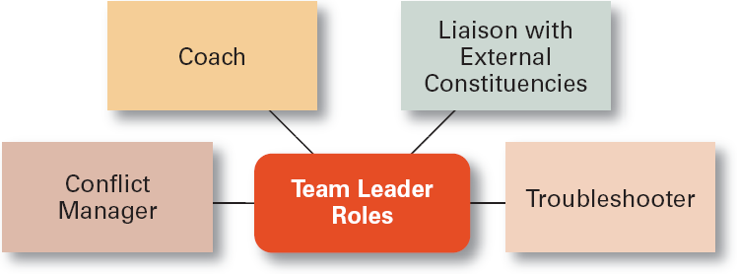
Exhibit 17–8 Specific Team Leadership Roles
© 2007 Prentice Hall, Inc. All rights reserved.
17–<number>

Slide 30
Leadership Issues in the 21st Century
Managing Power
  Legitimate power
    The power a leader has as a result of his or her position.
  Coercive power
    The power a leader has to punish or control.
  Reward power
    The power to give positive benefits or rewards.
  Expert power
    The influence a leader can exert as a result of his or her expertise, skills, or knowledge.
  Referent power
    The power of a leader that arise because of a person’s desirable resources or admired personal traits.
© 2007 Prentice Hall, Inc. All rights reserved.
17–<number>

Slide 31
Developing Credibility and Trust
Credibility (of a Leader)
  The assessment of a leader’s honesty, competence, and ability to inspire by his or her followers
Trust
  Is the belief of followers and others in the integrity, character, and ability of a leader.
    Dimensions of trust: integrity, competence, consistency, loyalty, and openness.
  Is related to increases in job performance, organizational citizenship behaviors, job satisfaction, and organization commitment.
© 2007 Prentice Hall, Inc. All rights reserved.
17–<number>

Slide 32
Exhibit 17–9 Suggestions for Building Trust
Practice openness.
Be fair.
Speak your feelings.
Tell the truth.
Show consistency.
Fulfill your promises.
Maintain confidences.
Demonstrate competence.
© 2007 Prentice Hall, Inc. All rights reserved.
17–<number>

Slide 33
Empowering Employees
Empowerment
  Involves increasing the decision-making discretion of workers such that teams can make key operating decisions in develop budgets, scheduling workloads, controlling inventories, and solving quality problems.
  Why empower employees?
    Quicker responses problems and faster decisions.
    Addresses the problem of increased spans of control in relieving managers to work on other problems.
© 2007 Prentice Hall, Inc. All rights reserved.
17–<number>

Slide 34
Gender Differences and Leadership
Research Findings
  Males and females use different styles:
    Women tend to adopt a more democratic or participative style unless in a male-dominated job.
    Women tend to use transformational leadership.
    Men tend to use transactional leadership.
© 2007 Prentice Hall, Inc. All rights reserved.
17–<number>

